Slide 1
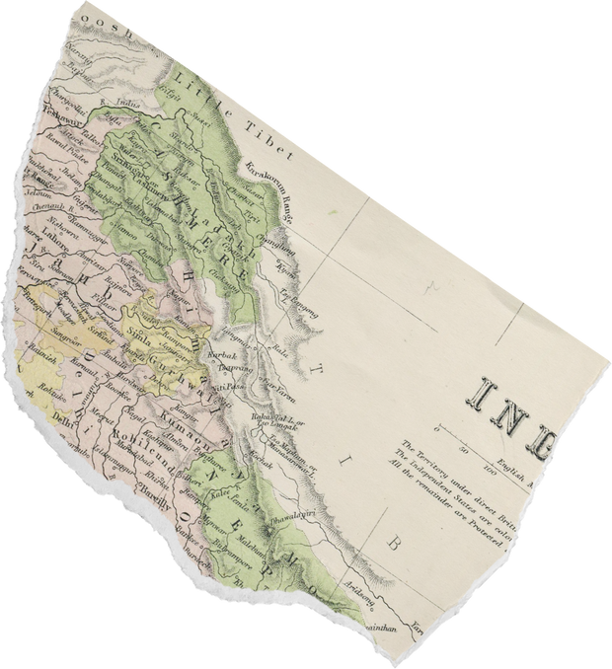
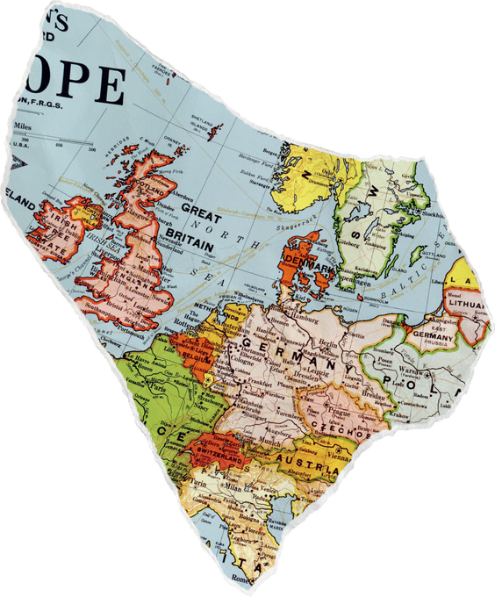
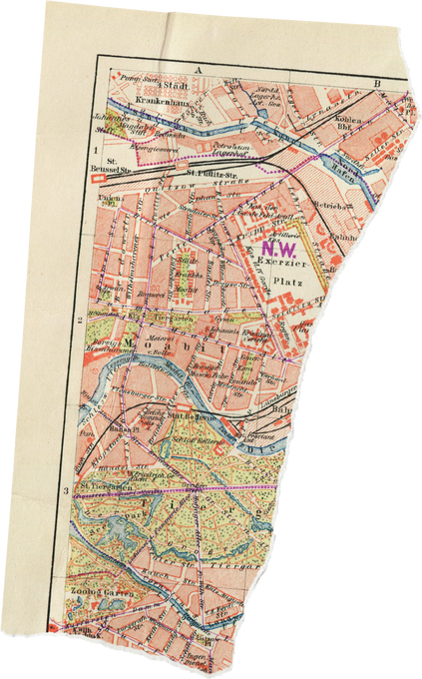
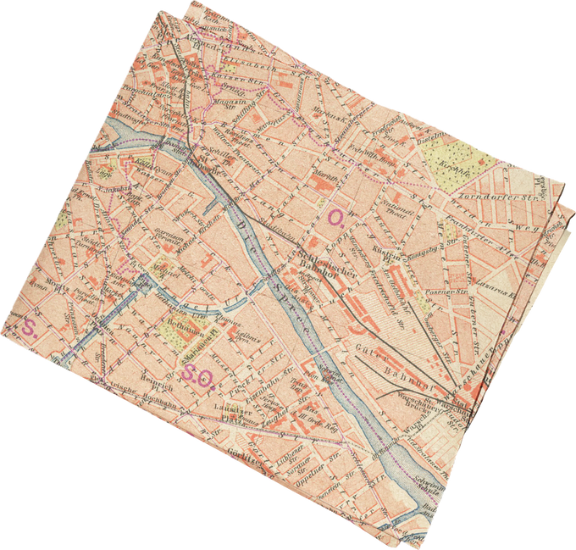
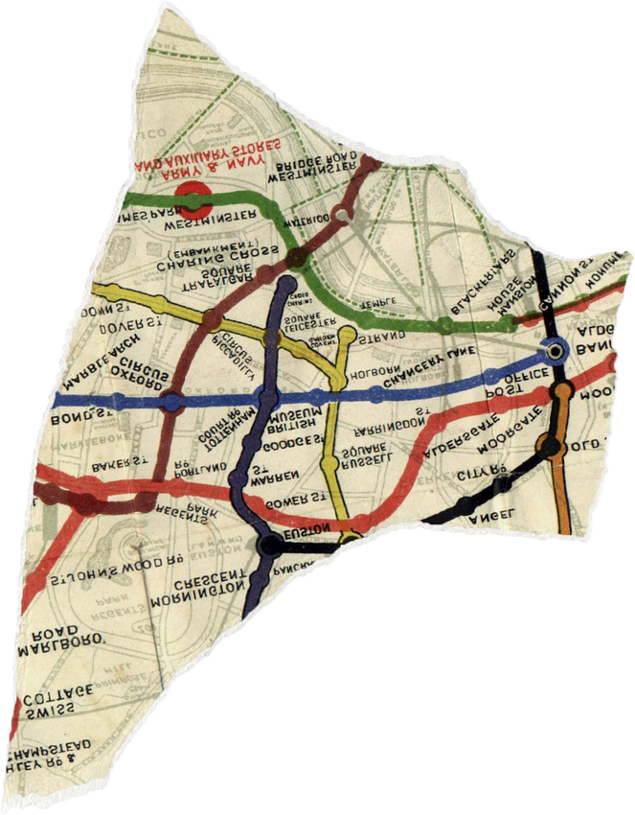
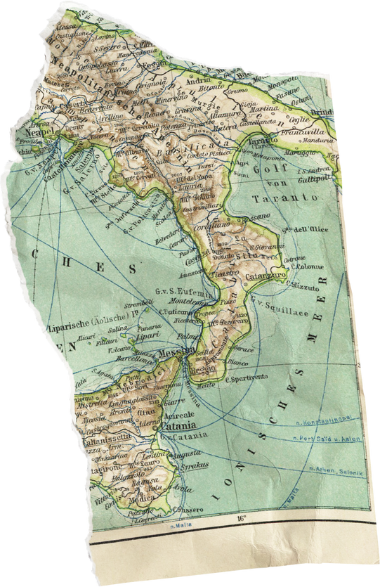

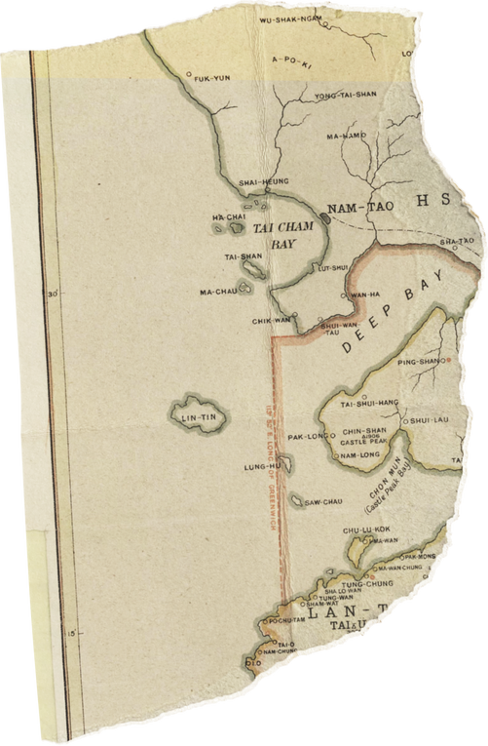
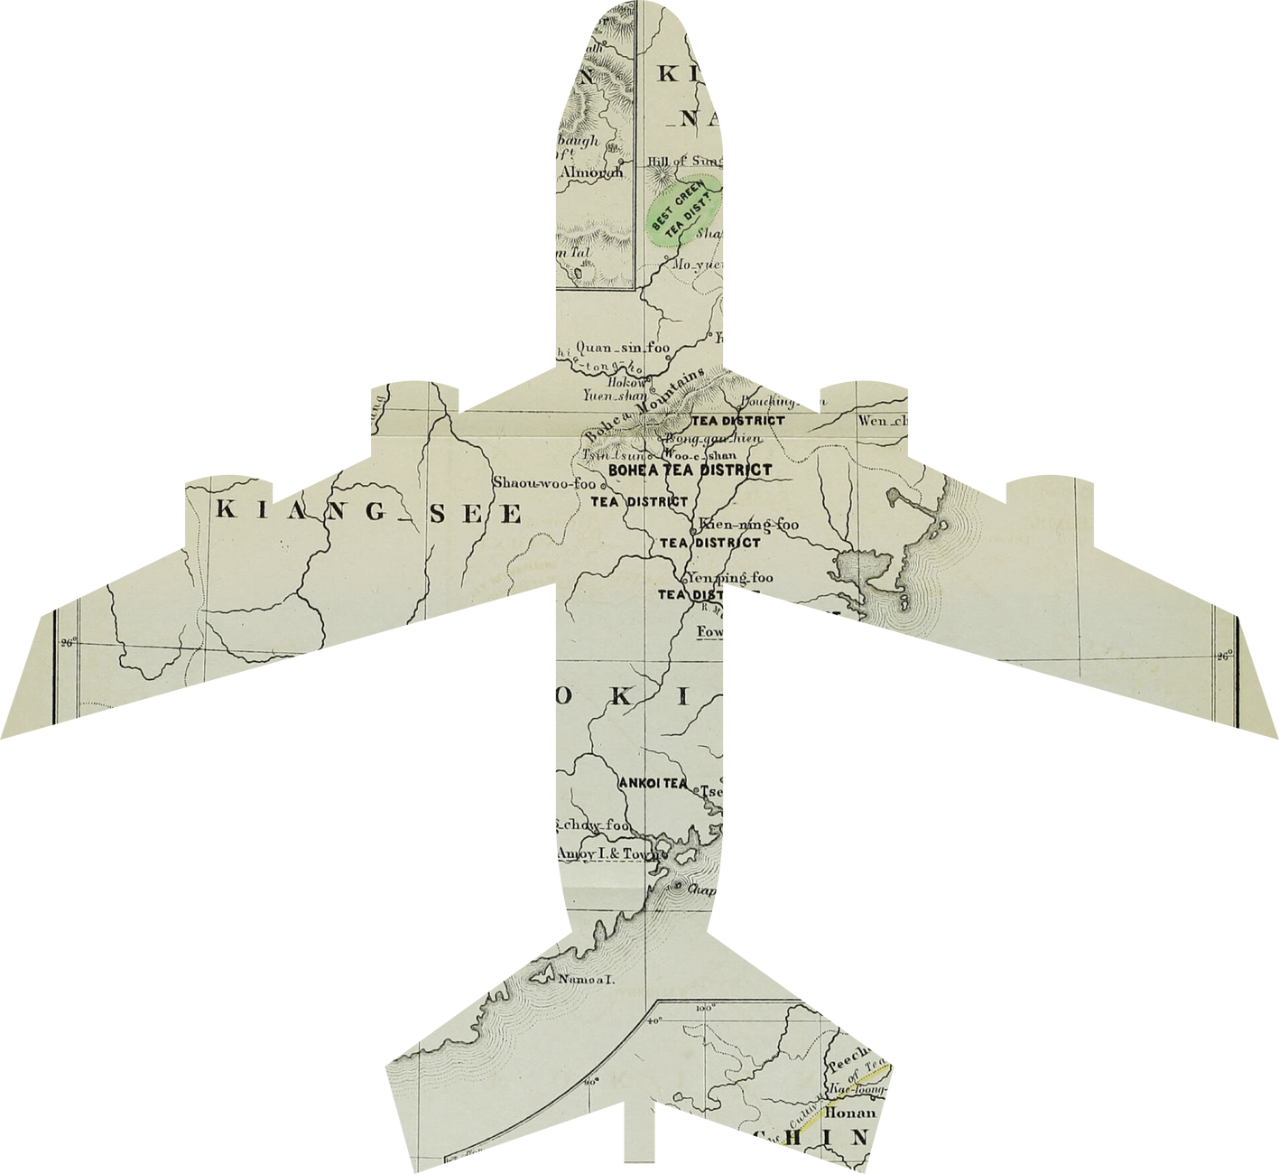

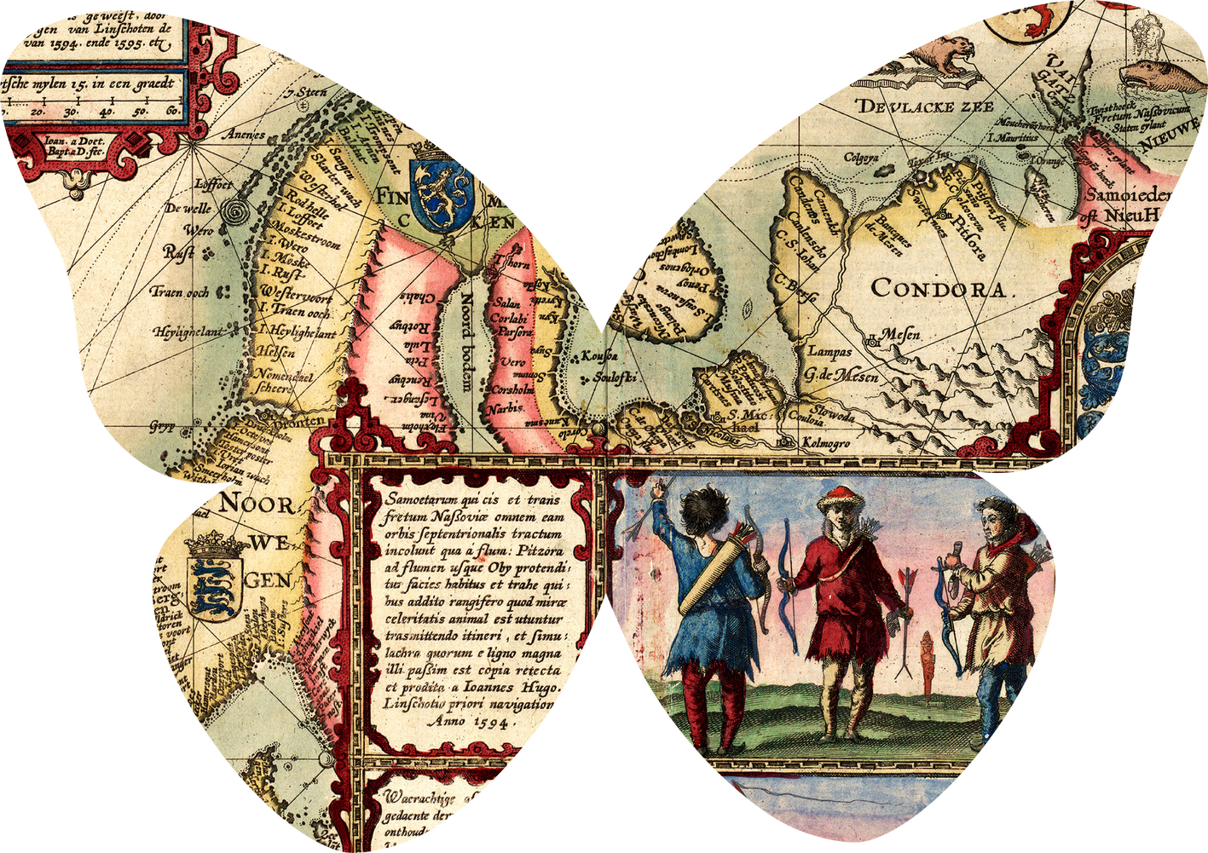
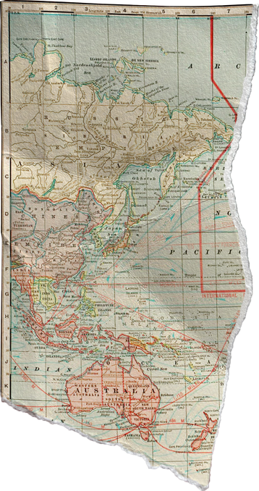
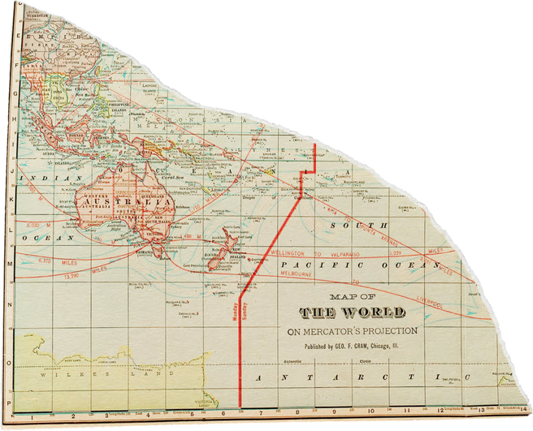
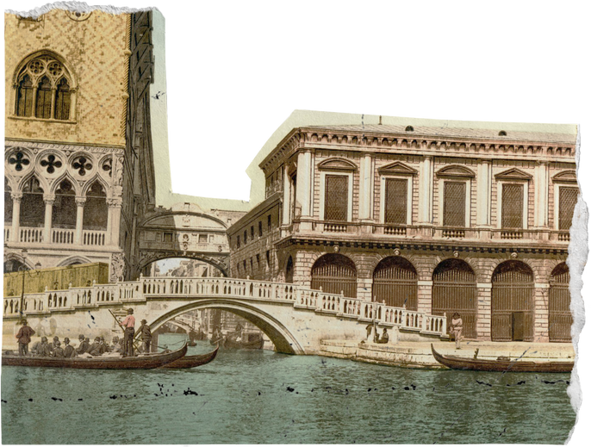
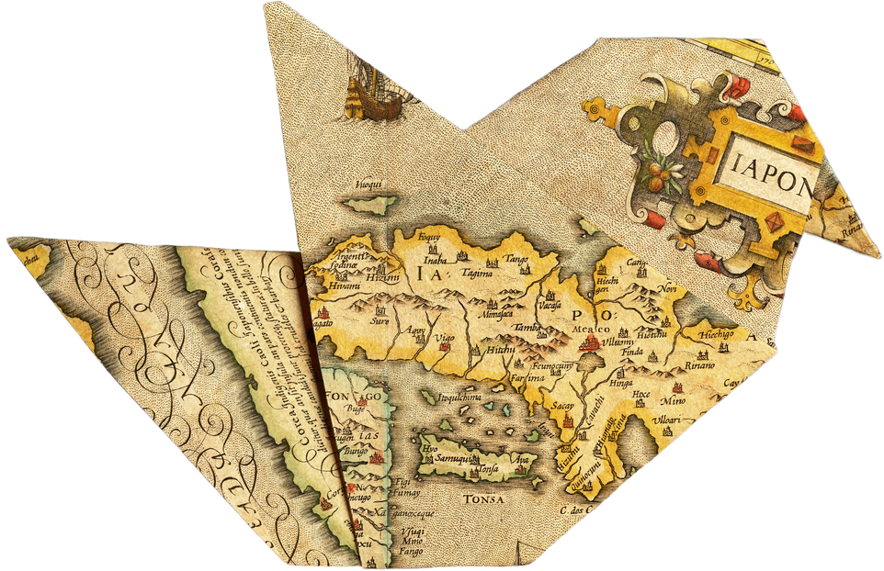
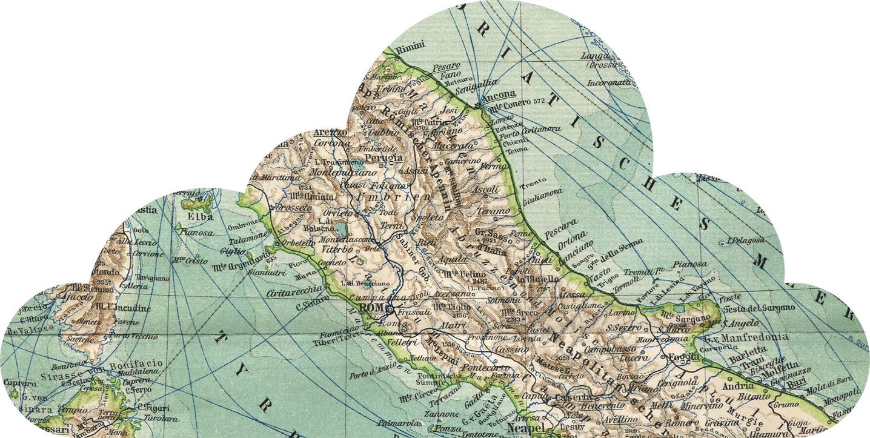
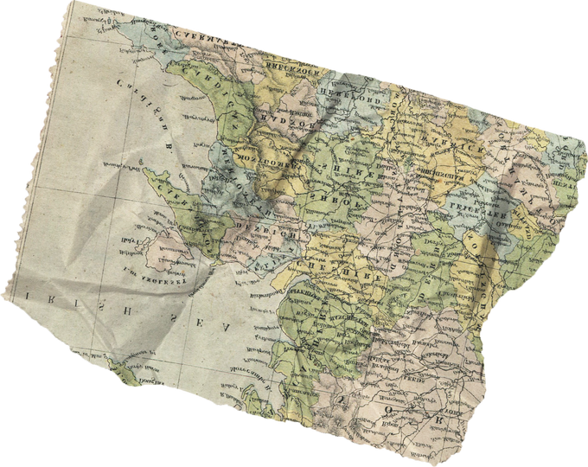
DEV{thon}
1.0

Slide 2
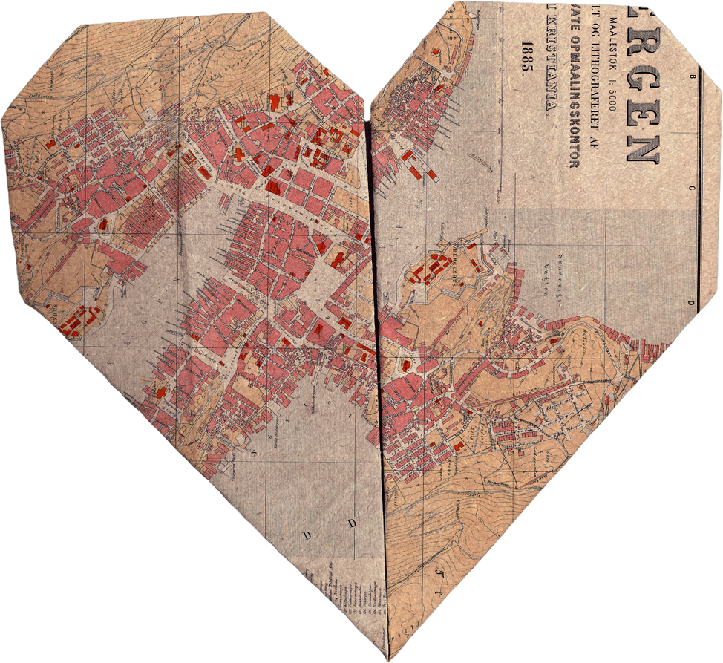
Team Details​
Team Name: BrainLeft
Team Leader: D.M.A.K.Dissanayake
Contact Email: ashidudissanayake1@gmail.com
Contact Phone: 071-9367715

Slide 3
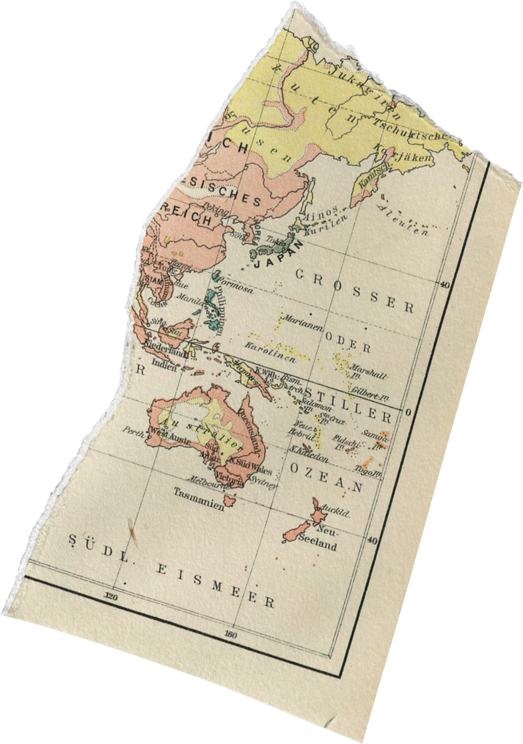
Project Details​
Project Title:
“Traveller”
Your Ultimate Travel Companion ​

Slide 4
1. Project Overview
Traveller is an innovative travel guide website designed to transform the way individuals plan and experience their trips. By seamlessly integrating advanced technologies and personalized services, Traveller aims to streamline the entire travel process, making it hassle-free and enjoyable for users.

Slide 5
2. Problem Statement​
Traditional travel planning can be time-consuming, overwhelming, and often lacks personalization. Tourists struggle to find a one-stop platform that caters to all their travel needs, from itinerary planning to bookings and cultural insights.

Slide 6
3. Proposed Solution​
Traveller provides a comprehensive solution by creating an all-in-one platform that simplifies travel planning. Users register as travellers, providing their preferences and details. The website utilizes a machine learning module to analyze user data and generate personalized trip itineraries. From destination selection to accommodation, transportation, and recreational activities, our platform covers it all.

Slide 7
4. Key Features:
1. User Registration: Travellers can create profiles, inputting their preferences, budget, and travel dates.
2. Map Interface: An interactive map allows travellers to choose their desired destinations and explore points of interest.
3. Personalized Trip Planning: Utilizing machine learning, the system generates customized itineraries based on user preferences.
4. Ticket Booking: Seamless integration with travel agencies for flight and event ticket purchases directly on our platform.
5. Accommodation Booking: Travellers can book resorts, guest houses, and other accommodations through our site.

Slide 8
4. Key Features:
6. Transportation Services: Booking options for various modes of transportation, including rental cars and guided tours.
7. Leisure Activities: If travellers want to relax, we can arrange recreational activities based on their preferences.
8. Historical and Cultural Insights: Engaging content on historical stories and information about the chosen destinations.
9. Reviews: Travellers can read and leave reviews for destinations, services, and other user experiences.

Slide 9
5. Technology Stack:
-Frontend: ReactJS
-Backend: Node.js
-Database: MongoDB
-Machine Learning: Python (Scikit-learn, TensorFlow)
-Payment Gateway Integration: Stripe
-Maps API: Google Maps

Slide 10
6. Innovation:
The integration of machine learning for personalized trip planning sets Traveller apart from traditional travel websites.

Slide 11
7. Feasibility Analysis:
Our team possesses the necessary technical expertise, and the availability of APIs for maps, booking, and payment systems makes the project feasible. Regular updates and security measures will be implemented to ensure scalability and reliability.

Slide 12
8. Impact Assessment:
Traveller has the potential to transform the travel industry by providing a user-friendly, personalized experience. It aims to increase user satisfaction, reduce planning stress, and contribute to the growth of the online travel market.

Slide 13
9. Additional Information:
Ongoing customer support, regular updates, and partnerships with travel-related businesses will be essential to the success and growth of Traveller. Continuous feedback loops will be implemented to improve user experiences and keep the platform relevant to evolving travel trends.

Slide 14
Thank you very much!

